Slide 1



Effective use of starter activities in language lessons

Slide 2

Aim of todays’ session:
Understand the _ _ _ _ _ _ _ why we use _ _ _ _ _ _ _ _ in lessons
Learn some _ _ _ _ _ _ _activities which can be use in class and online
Be able to use starters _ _ _ _ _ _ _ _ _ _ _ in lessons
Complete de gaps with the words below.
Write the 4 words in order in the chat.
starter starters effectively reasons

Slide 3
Starters
Why?
- To recap the previous lesson
- To point them out in the right direction
- To get them motivated
- To get their long-term memory back in gear
- To get them settled
- To get them stirred
- To assess?

Slide 4

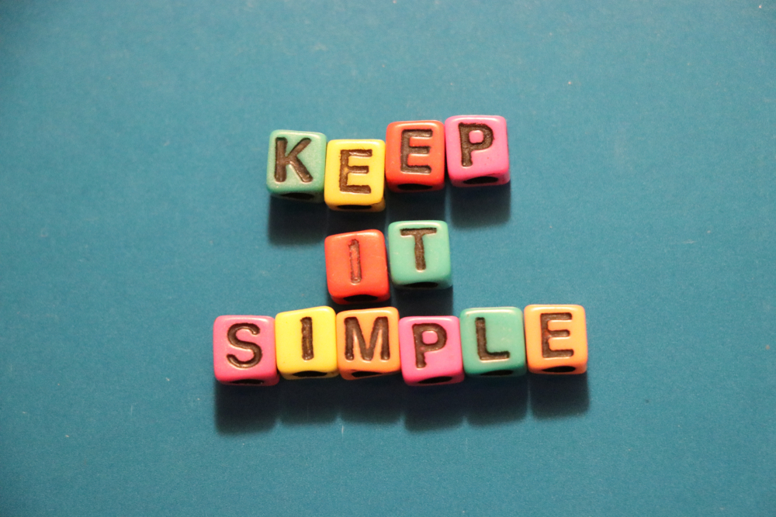
Few rules for effective starters:
No longer than 7 minutes. (5 mins recommended) Keep it snappy. Use a timer/ the length of a song/ the register.
Easy intructions which don’t require long explanations and questions.
Ask students if they have any questions about it before you get them started.
Not a time to teach something complicated/ new concept.
Self-assessment is easier. Peer-assessment if students are quick

Slide 5

At the end of today’s session, I will ask:
How many “starters” have you seen today?
You need to keep track of the number of starters I use and at the end of the lesson, the person with the most accurate list will win a prize! (virtual prize)
This one counts as your first one.
Great way to keep your active, engaged, higher level pupils thinking!
Great way to engage competitive boys! (and girls)
Great way to keep pupils looking out for new learning!

Slide 6
Using the word להסתכל, how many other words of three or more letters can you make?
ל ה ס ת כ ל– example כלה
You can use a letter twice
Using the word trabajadora, how many other adjectives of three or more letters can you make?
trabajadora– example baja
Don’t forget to try it first!
Differentiation: Have a list of words which contains the letters and some that don’t and students have to copy the ones that do.
Extension: Give students a minimum number of words to find. Give them a topic or group of words.

Slide 7
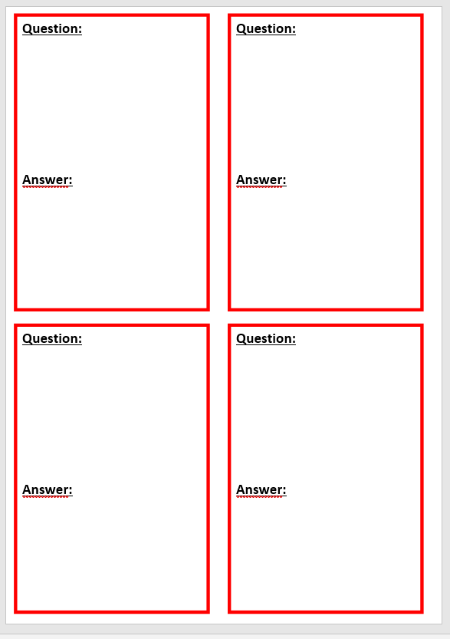
Starters which serve as plenaries
Question:
Answer:
Today’s Topic is “Starters and Plenaries”, what question would you really like answered today?
During the course of the session, if the question is answered, write the answer down on your card.
If you can’t think of a question now, write one down during the session, that shows something new that you learn today!
https://padlet.com/sarahwagman/8shrg5rp4pzyy0k9

Slide 8
Categorising
Put some words on the board
Students need to categorise them
There can be a right or wrong answer
or not
Group these words in any way you want. You will have to explain your grouping and give the group a title.
Green Red Grumpy
Blue Bold Clumsy Young
Rich Yellow Funny Bright
Happy Sad
Don’t forget to try it first!
Differentiation: Give the categories
Extension: asked students to add their own words in the groups
How could ask students to categorise words?

Slide 9

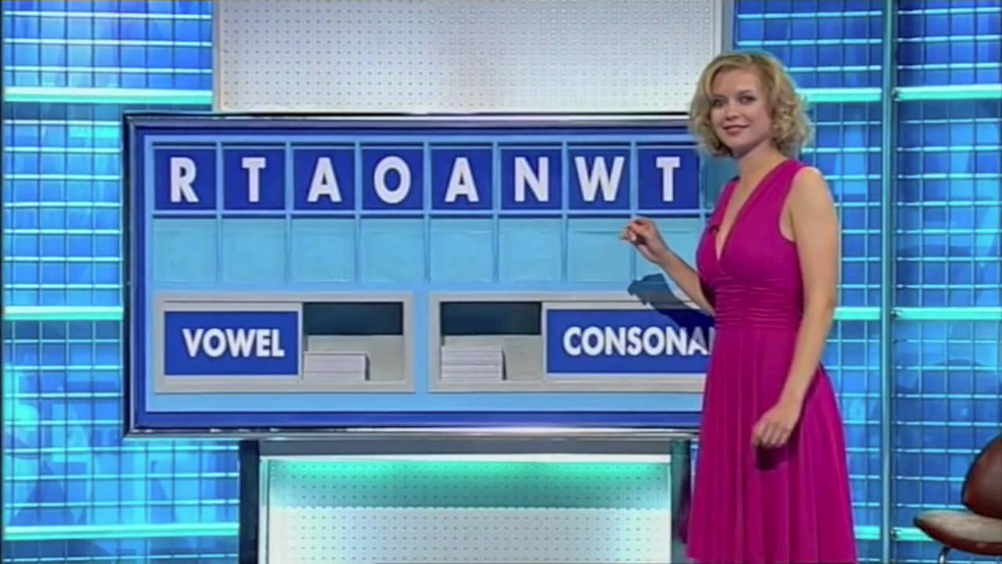
Countdown or conundrum
Write down 8 letters
Students have to make the longest word possible
Or students have to find the 8 letter word hidden
ל
ה
א
ו
ב
ד
ת
ג
Don’t forget to try it first!
To make it more like the game and kineasthetic, have students pick the consonants and the vowels. Out of a bag ready at the entrance of the class.
Differentiation: Make sure the word is a word from the topic they know. In Hebew, add the vowels.
Extension: Add a clock like on the game show. This is very stressful.

Slide 10
Anagrams
Write 10 words with letters of words all jumbled up
Students have to work out the word / unscramble the key words for the lesson
STRTAER
CAIITYVT
SCAMLSORO
Starter
Activity
Classroom
Differentiation: don’t give this to students with dyslexia. You could give them the words to match
Extension: use words from different topics not necessaraly from the lesson or previous lesson. Asked students to explain how the words are linked.

Slide 11
Speaking starter
In pairs, student ask a list of questions to their partner and they switch
What’s your name?
What is your favourite sweet?
What is your favourite TV show.
Differentiation: Put the questions and the answers on the bard. Aim is to practise speaking. (transliteration/ pronunciation support allowed)
Extension: Only put a topic on the board and students have to think of their own questions

Slide 12
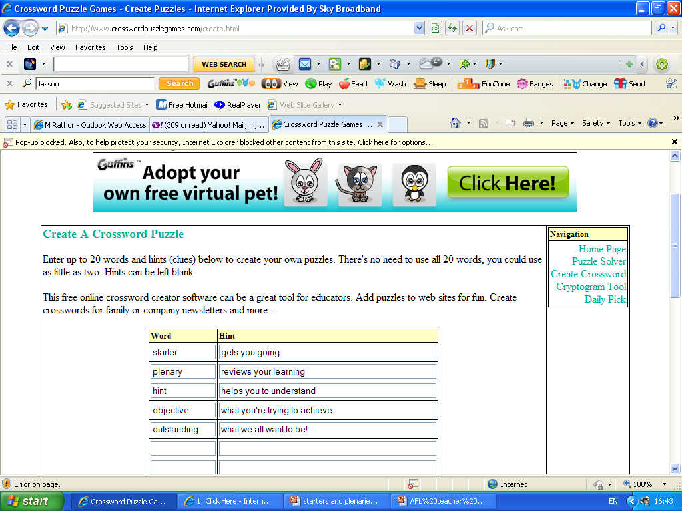
Crossword
Use key words from the previous lesson or the current lesson to create a crossword.
This can be with words in English to TL. TL to English or definition to TL word.
http://puzzlemaker.discoveryeducation.com/
http://www.crosswordpuzzlegames.com/create.html

Slide 13
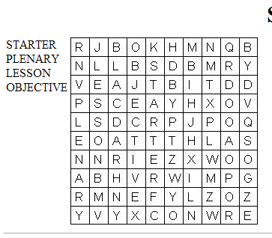
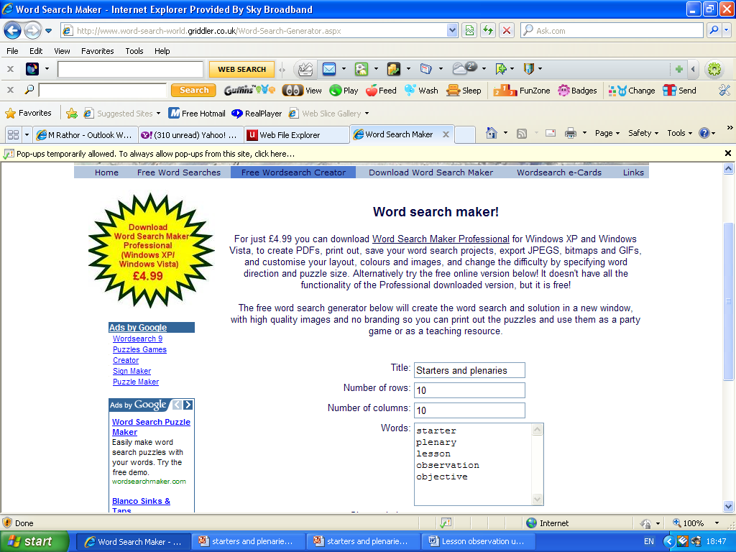
Wordsearch
Fill the word search with the lesson’s key words:
http://www.word-search-world.griddler.co.uk/Word-Search-Generator.aspx

Slide 14

Matching up
https://quizlet.com/543373044/match
Match the English and the TL Match the beginning of a sentence and the end
Match a picture and TL Match synonyms/ antonyms in TL
Match a noise and TL Match family words in TL
Match the word and the definition Match pairs
Starter
Plenary
Lesson objectives
Summative assessment
goes at the end of the lesson
how the lesson opens
giving the pupils the grade that they’re working at
What you want pupils to learn

Slide 15

Image
Use a key image from the lesson or previous lesson
Pupils label the pictures according to ability/ level/ class
Just words: eg: green, carrot
Sentences: there is a boy
Description: the boy looks happy
Opinion: I like the picture because…
Put a caption: We love vegetables!!!

Slide 16
Draw what you remember
Students draw a picture of what they remember from last lesson
Students write as many words as they remember from last lesson

Slide 17
My favourite own!
ל
ל
מ
ד
ע
ב
ר
י
ת
Put a word related to the topic you are teaching vertically on the baord.
Students write words which start with the letters in the long word
Students write words which finish with the letters in the long words
Students write words in the middle of the letters in the long words
Words related to topic or not related
Students write sentences
Students write sentences which link together

Slide 18
Let’s go back to our first starter
How many “starters” have you seen today?

Slide 19
What now?
In pairs,
in breakout rooms
Which was your favourite starter?
Which one are you going to use? When? With which class? Which topic?
Any questions?

Slide 20
Further Links:
http://www.teachers.tv/series/lesson-refreshers
http://www.word-search-world.griddler.co.uk/Word-Search-Generator.aspx
http://www.word-search-world.griddler.co.uk/Word-Search-Generator.aspx
www.classtools.net
http://outstanding-lessons.wikispaces.com/Starters+and+Plenaries
http://www.fionahogg.com/Unit5Startersandplenaries.pdf
www.padlet.com
www.H5p.org
www.quizlet.com

Slide 21
Aim of todays’ session:
Understand the reasons why we use starters in lessons
Learn some starter activities which can be use in class and online
Be able to use starters effectively in lessons

